Slide 1


Guide to use TestLink
For tester role

Slide 2
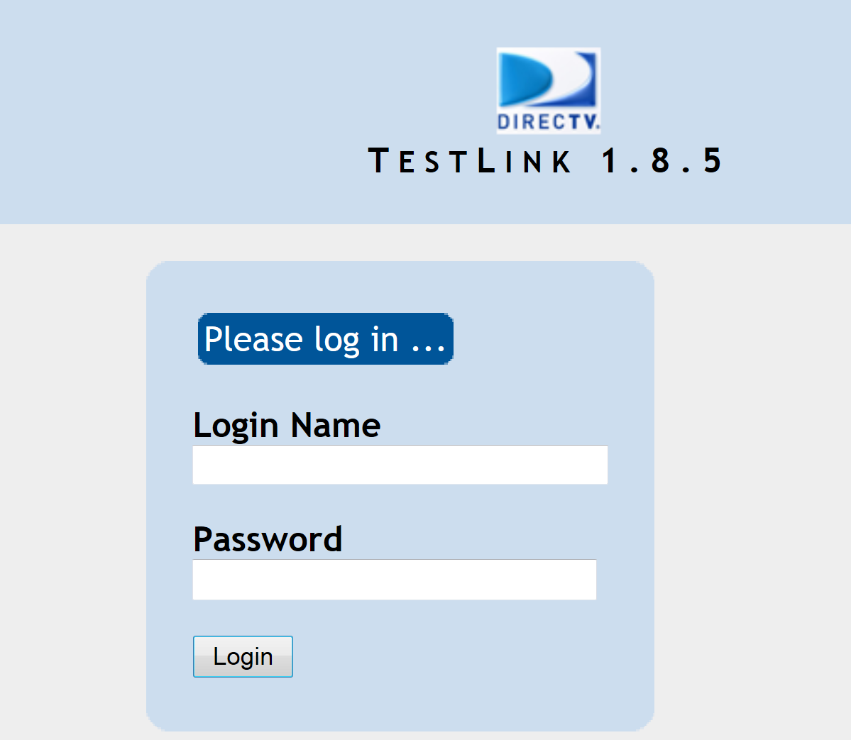
Overview
This course will guide through the normal workflow of a tester when working with TestLink.

Slide 3
What Testers need to know?
How to get his/her assignments in TestLink.
How to report his/her test progress.
How to query test result.

Slide 4
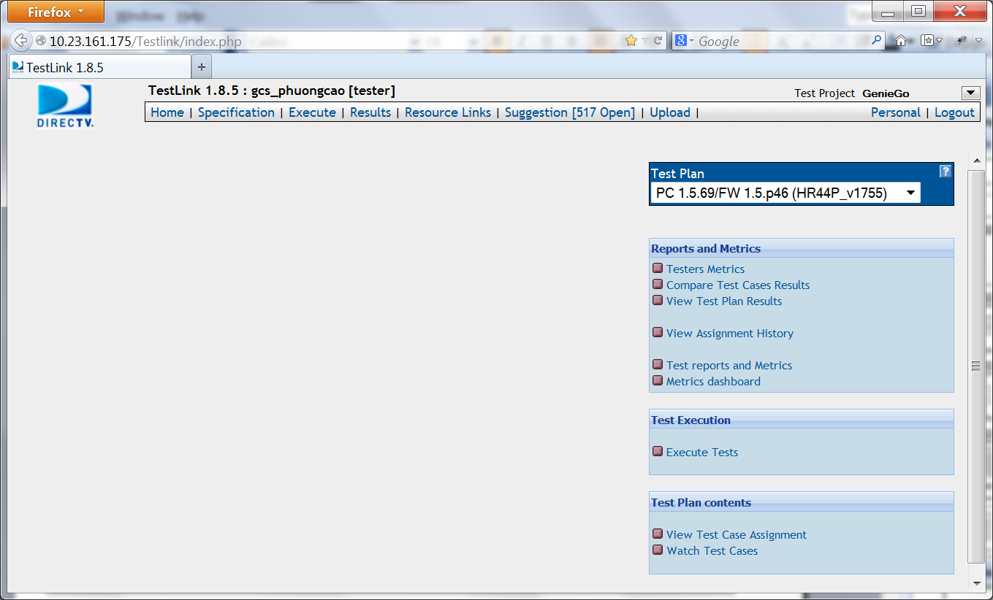
Finding assigned test – Home page
After logging in, this is the home page of TestLink.
To find the test case, tester must do the following:
Select Test Project
Select Test Plan
Select Execute Tests under Test Execution

Slide 5
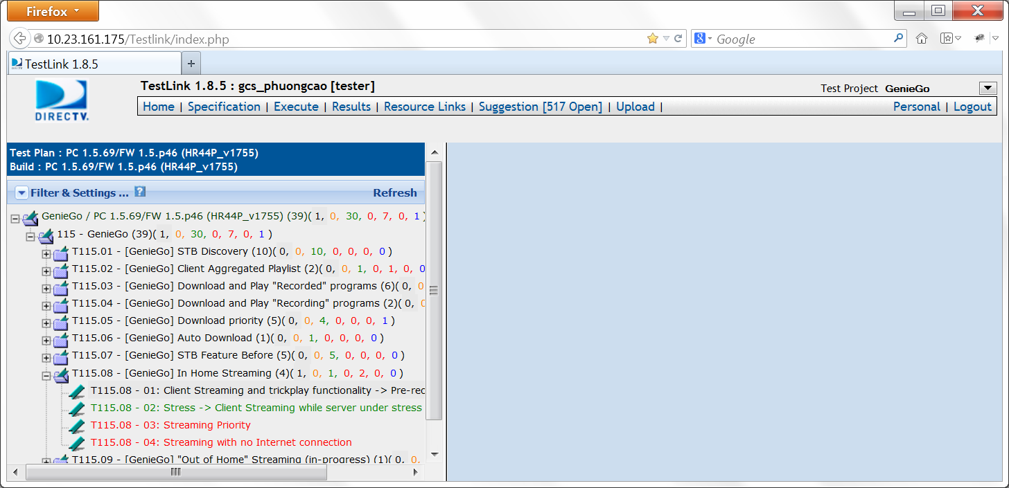
Finding assigned test – Test cases page
The test cases page will be displayed after selecting Execute Tests.
Test cases are listed in tree formation. Similar test cases are grouped in Test suite.
By default only test cases assigned to the currently logged in tester will be shown.

Slide 6
What Testers need to know?
How to get his/her assignments in TestLink.
How to report his/her test progress.
How to query test result.

Slide 7
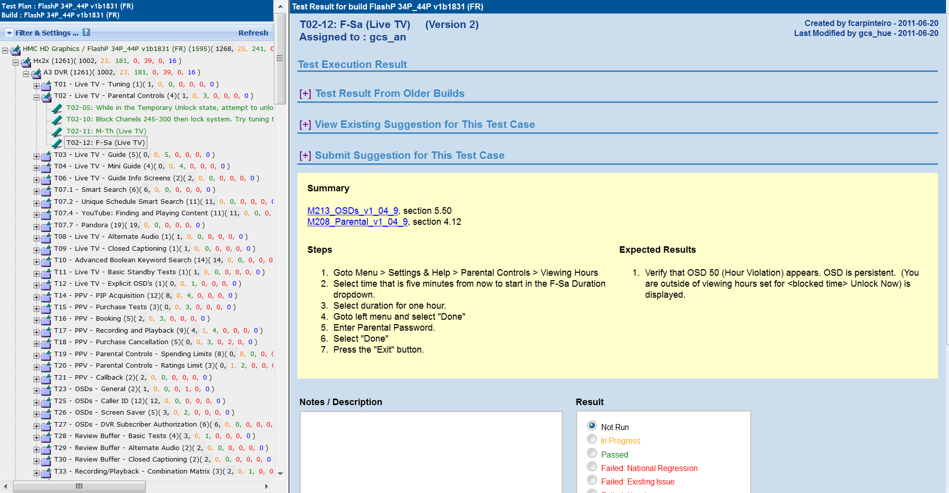


Test Progress - Executing test case
When a test case is selected from the tree list the central panel will show the following:
Test case ID and Test Case Name.
To whom the test case is assigned.
Summary, Steps and Expected Results.
Result box and Notes/Description.
Tester follows steps and compares expected result with actual result then save the result.

Slide 8
Test Progress: Result box
After executing the test case, tester must provide the result. The result should
fall into one of the following statuses:
Not Run: This is the initial state for a test case that has never been run. If you execute a test case and save execution result, then you will never be able to revert back to the "Not Run" state. “Not run” is only an initial state for each build.
In Progress: This means that you are executing a test case that requires a few hours to run. For example, test cases that require that you check the expiration of a PPV 24-hour rental period or setting up a GameSearch recording on NFL games that only happen on Sunday.
Passed: A test case is deemed to pass if its actual result matches its expected result
Blocked (explain in note): This state means that the test case was blocked and this test case cannot be run by anyone else (assignee is not set _ToReassign). Tester must explain the reason for blocking.

Slide 9
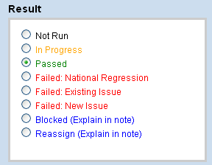
Test Progress: Result box (cont.)
There are 3 types of failure.
Failed: National Regression: The test case fails in current build, but passes in current national build.
Failed: Existing Issue: It's not a national regression and there's an opened JIRA ticket.
Failed: New Issue: It's not a national regression and there's no opened JIRA ticket.

Slide 10
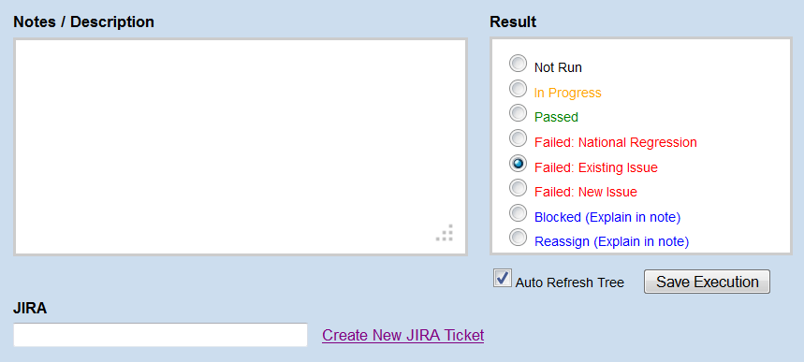
Test Progress: Failed Test Case
When test case Failed Existing Issue, tester must link the opened JIRA ticket to the test case by inputting the JIRA ticket ID in to the JIRA field in Testlink.
Tester should also update the ticket in JIRA (add the Affects version, logs, etc…)

Slide 11

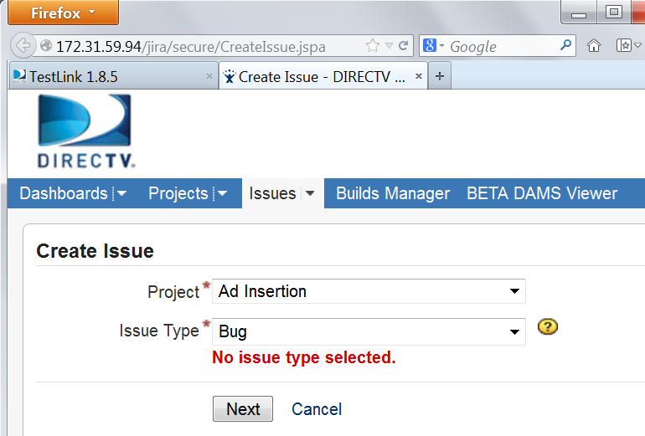
Test Progress: Failed Test Case (cont.)
When test case Failed New Issue testers can quickly create new JIRA ticket by clicking on the link “Create New JIRA Ticket”. They will be directed to JIRA page.
After creating the ticket, tester can fill the ticket ID in to JIRA field in Testlink.

Slide 12
What Testers need to know?
How to get his/her assignments in TestLink.
How to report his/her test progress.
How to query test result.

Slide 13
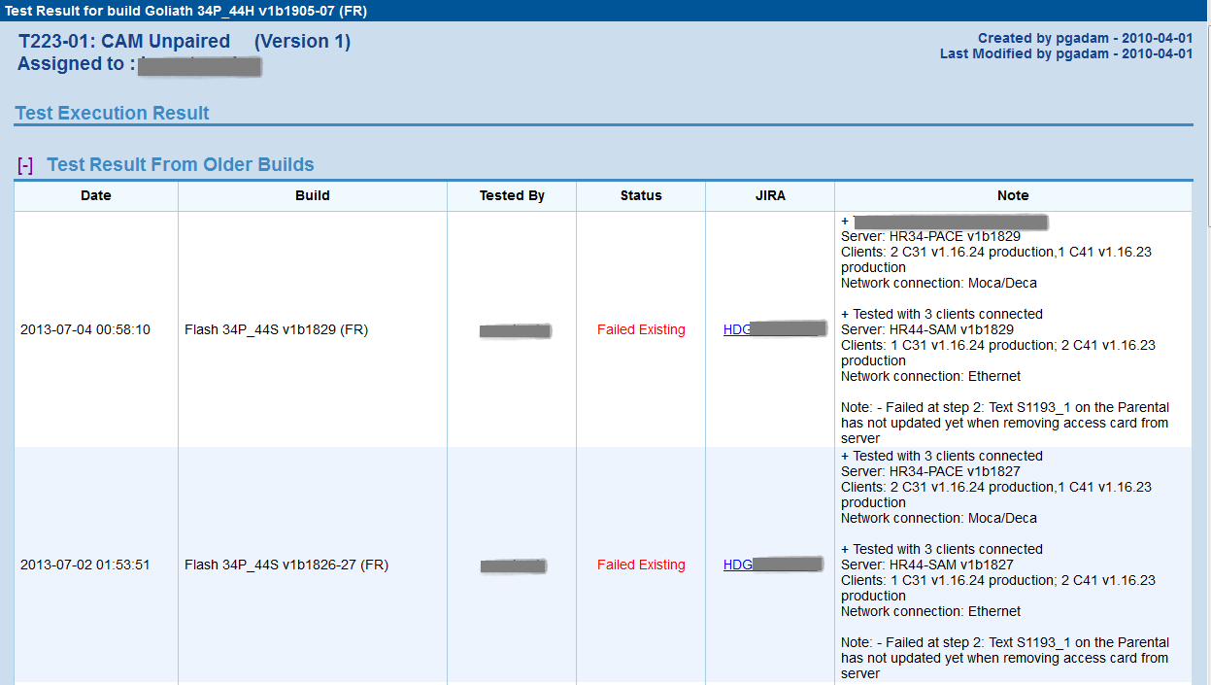
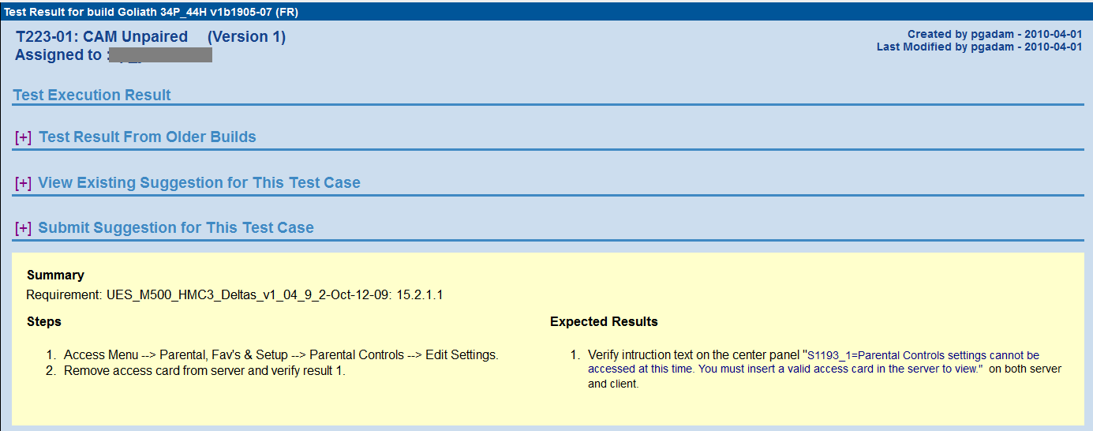
Searching for test results from older builds
TestLink stores all the test results from older builds. Tester can see it by expanding the field “Test Result From Older Builds”

Slide 14
Thank you

